Slide 1
Mining Semi-Structured Online Knowledge Bases to Answer Natural Language Questions on Community QA Websites
Date： 2014/12/04
Author： Parikshit Sondhi, ChengXiang Zhai
Source： CIKM’14
Advisor：Jia-ling Koh
Speaker：Sz-Han,Wang

Slide 2
Outline
Introduction
Method
Experiment
Conclusion

Slide 3
Introduction
Community QA (cQA) website such as Yahoo! Answers are highly popular.
  X Not receive informative answer
  X Not answered in a timely manner
Many of the questions may be answerable via online knowledge-base websites such as Wikipedia or eMedicinehealth.

Slide 4
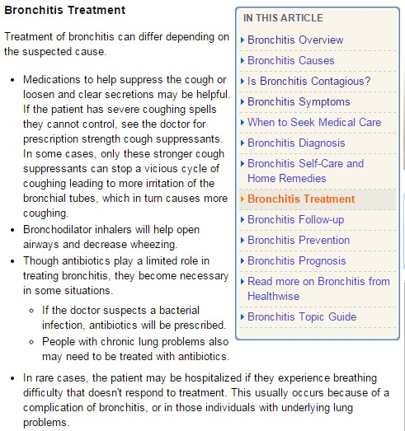
Introduction
Disease entity: “Bronchitis”
Aspect: “cause” , “symptoms” , “treatment”……
Being organized in a relational database
  Relation “(Disease , Treatment)”
  → “(Bronchitis ,<text describing treatment of Bronchitis >)”
123

Slide 5
Introduction
Goal:
  Answer a new question by mining the mot suitable text value from the database.
  retrieving documents based only on keyword/ semantic
  relations between text value to perform limited “reasoning” via sql queries.
Symptoms | Treatment
symp1 | treat1
symp2 | treat2
User’ question describing a set of symptoms and expects a treatment description in response.
Answer:
  Select Treatment form Rel where Symptoms = symp1
Challenge: identify relevant sql queries that can help retrieve the answer to question.

Slide 6
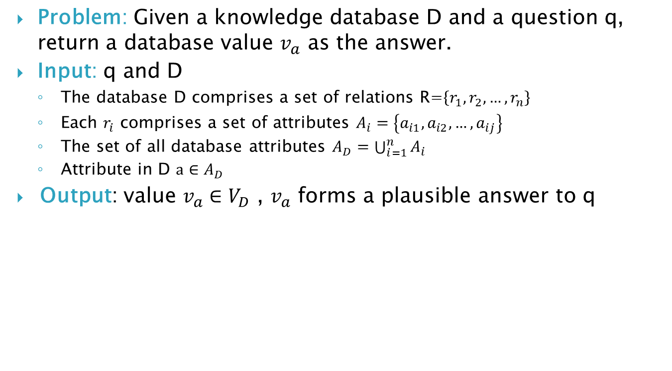
PROBLEM DEFINITION
Problem: Given a knowledge database D and a question q, return a database value $v_{a}$ as the answer.
Input: q and D
  The database D comprises a set of relations R=$\left\{r_{1},r_{2},…,r_{n}\right\}$
  Each $r_{i}$ comprises a set of attributes $A_{i}=\left\{a_{i1},a_{i2},…,a_{ij}\right\}$
  The set of all database attributes $A_{D}=\bigcup_{i=1}^{n}{A_{i}}$
  Attribute in D $a∈A_{D}$
Output: value $v_{a}∈V_{D}$ , $v_{a}$ forms a plausible answer to q

Slide 7
Outline
Introduction
Method
Experiment
Conclusion

Slide 8

FRAMEWORK FOR KBQA
candidate
answer
value
v1
v2
v3
….
a1
a2
a3
….
Identify value
similar to the question
Incorporate value
as constraints in sql queries
Rank
a3
a1
question
User’ question describing a set of symptoms and expects a treatment description in response.
value: symp1,symp2
Symptoms | Treatment
symp1 | treat1
symp2 | treat2
candidate answer: treat1,treat2

Slide 9
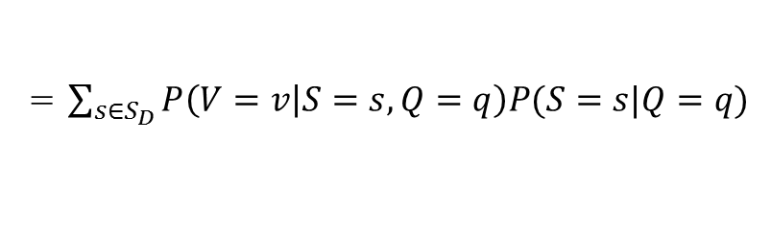
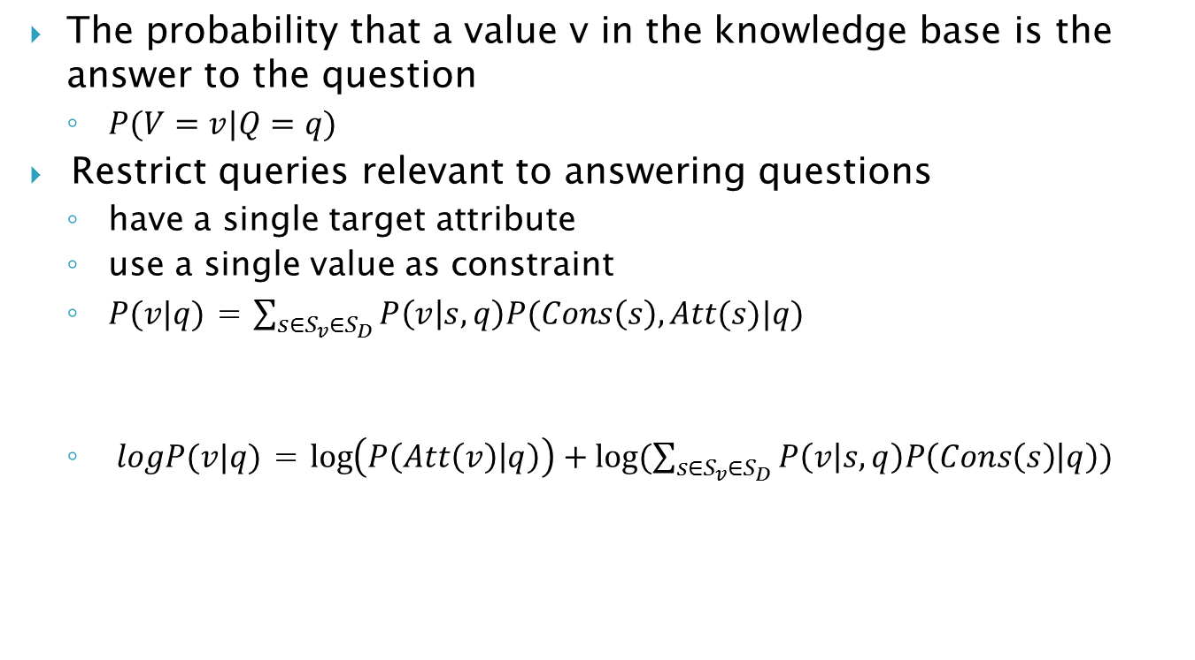

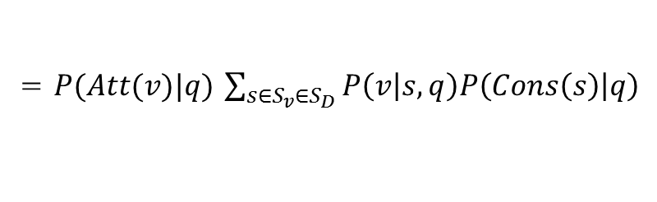
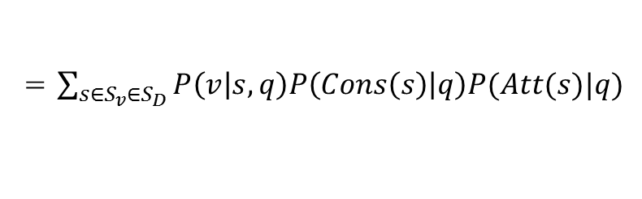
KBQA
The probability that a value v in the knowledge base is the answer to the question
  $P(V=v|Q=q)$
Restrict queries relevant to answering questions
  have a single target attribute
  use a single value as constraint
  $P(v|q)$ = $\sum_{s∈S_{v}∈S_{D}}{P\left(v | s,q\right)P(Cons\left(s\right),Att(s)|q)}$
  $logP(v|q)$ = $\log\left(P\left(Att\left(v\right) | q\right)\right)+log⁡(\sum_{s∈S_{v}∈S_{D}}{P\left(v | s,q\right)P\left(Cons\left(s\right) | q\right)})$
= $\sum_{s∈S_{D}}{P\left(V=v | S=s,Q=q\right)P(S=s|Q=q)}$
$$Cons\left(s\right)∈V_{D},Att(s)∈A_{D}$$
= $\sum_{s∈S_{v}∈S_{D}}{P\left(v | s,q\right)P\left(Cons\left(s\right) | q\right)P(Att(s)|q)}$
= $P(Att(v)|q)$ $\sum_{s∈S_{v}∈S_{D}}{P\left(v | s,q\right)P\left(Cons\left(s\right) | q\right)}$

Slide 10
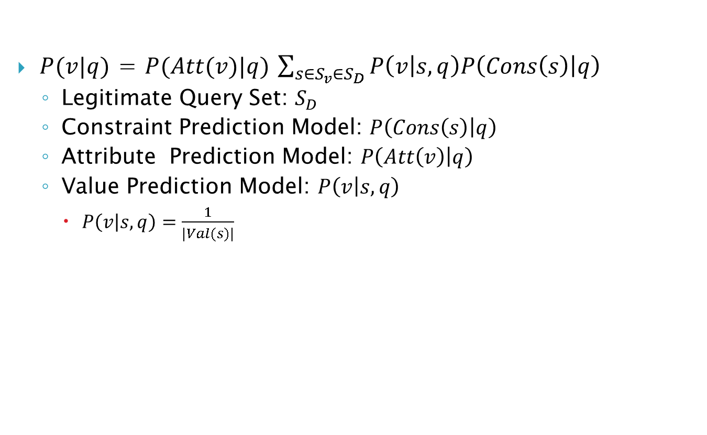
KBQA
$P(v|q)$ = $P(Att(v)|q)$ $\sum_{s∈S_{v}∈S_{D}}{P\left(v | s,q\right)P\left(Cons\left(s\right) | q\right)}$
  Legitimate Query Set: $S_{D}$
  Constraint Prediction Model: $P\left(Cons\left(s\right) | q\right)$
  Attribute Prediction Model: $P\left(Att\left(v\right) | q\right)$
  Value Prediction Model: $P\left(v | s,q\right)$
    $P\left(v | s,q\right)=\frac{1}{|Val(s)|}$

Slide 11
Mining Legitimate Query Set
Identify a sql query given a question, its answer and knowledge base
  sql query: select Treatment from Rel where Symptoms = symp1
Identify a set T of such template
  template: select Treatment from Rel where Symptoms = <symptom value>
Symptoms | Treatment
symp1 | treat1
symp2 | treat2
User’ question describing a set of symptoms and expects a treatment description in response. →symp1
Answer: treat1

Slide 12
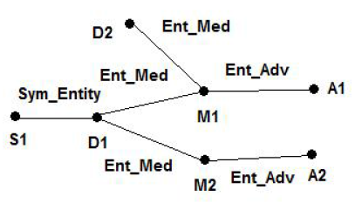

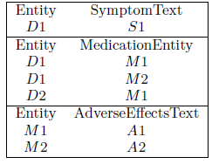
Mining Legitimate Query Set
Question matched the constraint S1
Answer contained the value A1
Obtain the shortest path between the two node
  S1→D1→M1→A1
From constraint node to answer node, add a new sql construct in each step
Step
S1→D1
select Entity from Entity_SymptomText
where SymptomText = S1
D1→M1
select MedicationEntity from Entity_MedicationEntity
where Entity=(select Entity from Entity_SymptomText
where SymptomText = S1)
M1→A1
Select AdverseEffectsText from Entity_AdverseEffectsText
where Entity=(select MedicationEntity from Entity_MedicationEntity
where Entity=(select Entity from Entity_SymptomText
where SymptomText = S1))
Select AdverseEffectsText from Entity_AdverseEffectsText
where Entity=(select MedicationEntity from Entity_MedicationEntity
where Entity=(select Entity from Entity_SymptomText
where SymptomText = <SymptomText value>))
query template

Slide 13




Constraint Distribution
Similarity function between the question and a database value

Slide 14

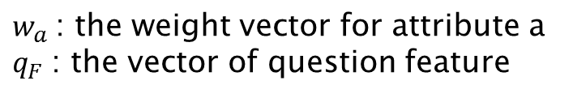
Attribute Distribution
Multi-class classification task over question features
  Question feature are defined over n-grams(for n=1 to 5)
$w_{a}$: the weight vector for attribute a
$q_{F}$: the vector of question feature

Slide 15
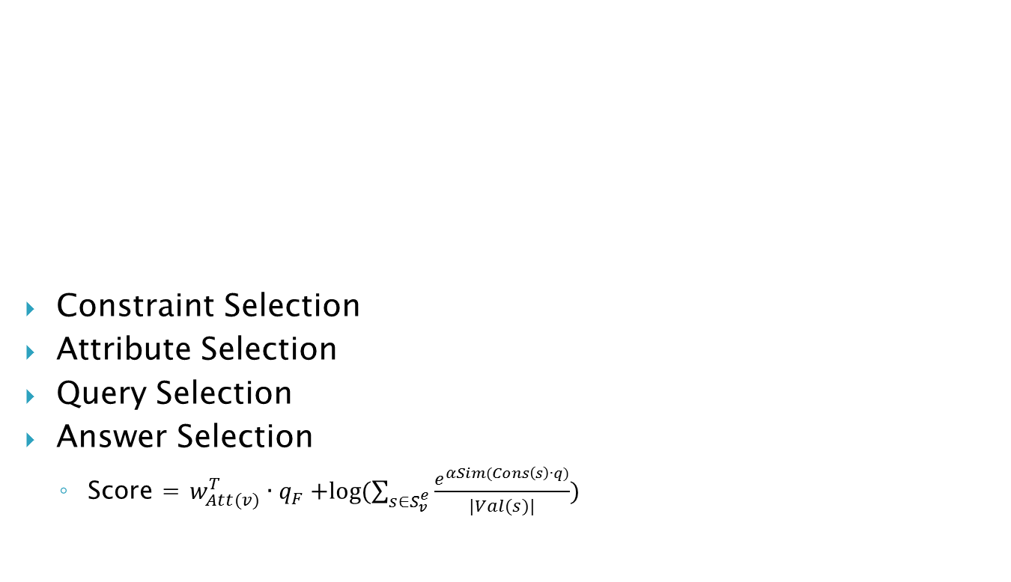
Answer Ranking
Constraint Selection
Attribute Selection
Query Selection
Answer Selection
  Score = $w_{Att(v)}^{T}{∙q}_{F}+log⁡(\sum_{s∈S_{v}^{e}}{\frac{e^{αSim(Cons\left(s\right)∙q)}}{|Val(s)|}})$
candidate
answer
value
v1
v2
v3
….
a1
a2
a3
….
Identify value
similar to the question
Incorporate value
as constraints in sql queries
Rank
a3
a1
question

Slide 16
Outline
Introduction
Method
Experiment
Conclusion

Slide 17
Experiment
Dataset: 80K healthcare question from Yahoo! Answers website
Database: wikipedia
Evaluation Metrics:
  Success at 1(S◎1)
  Success at 5(S◎5)
  Mean Reciprocal Rank(MRR)

Slide 18
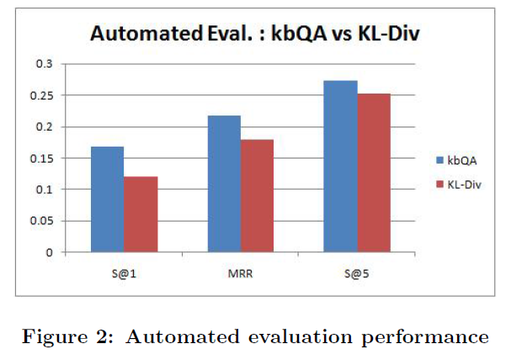
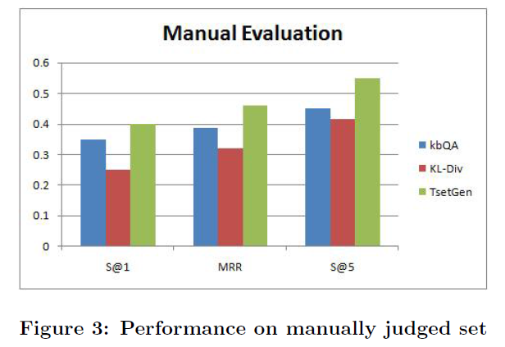
Experiment

Slide 19
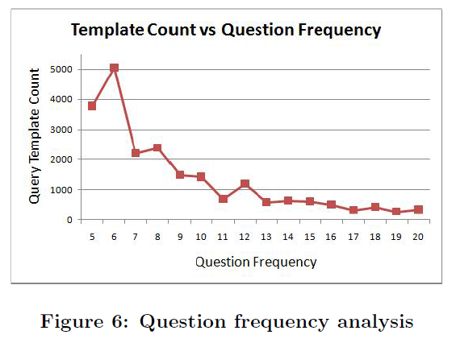
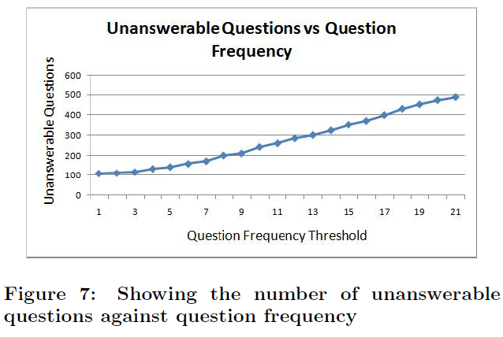
Experiment

Slide 20
Outline
Introduction
Method
Experiment
Conclusion

Slide 21
Conclusion
Introduced and studied a novel text mining problem, called knowledge-based question answering.
Proposed a general novel probabilistic framework which generates a set of relevant sql queries and executes them to obtain answers.
Evaluation has shown that the proposed probabilistic mining approach outperforms a state of the art retrieval method.
Our main future work is to extend our work to additional domains and to refine the different framework components.

